Slide 1
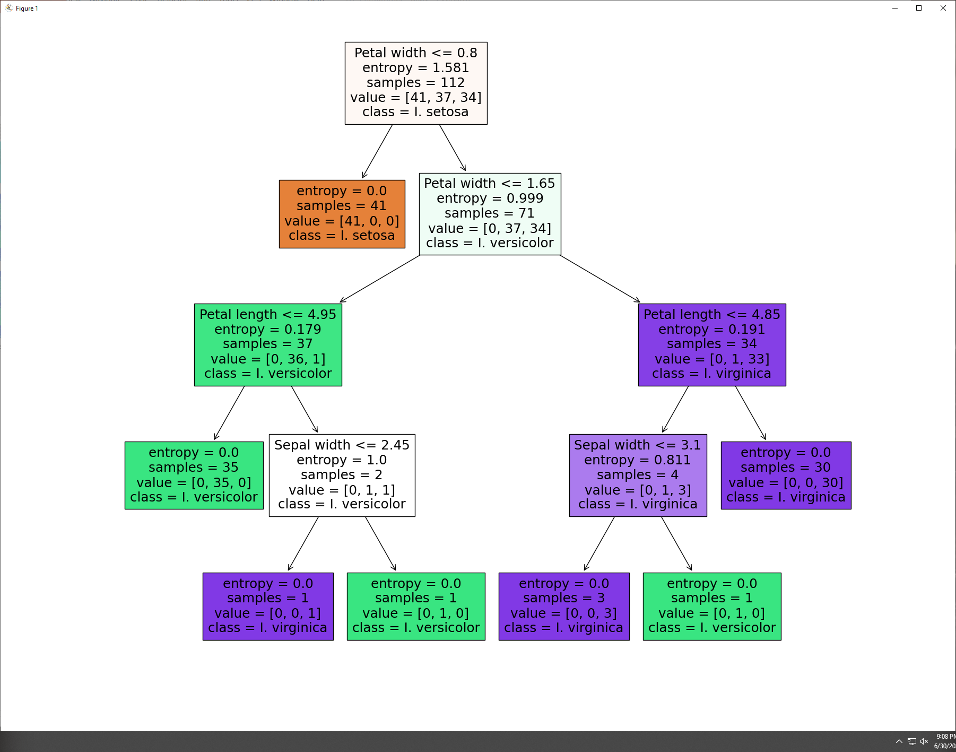
ITP 449
Decision Trees

Slide 2
C
A
R
T
Classification and Regression Trees

Slide 3
Difference: Classification and Regression
In classification we classify cases into specific classes. For example, we might take a set of people and classify them as potential customers or non-customers (based on some predictor attributes)
In regression, we are trying to predict a numerical value – like the annual income of a person, the price of a car, the sales volume or GPA or whatever.
As the name implies, CART can be used for both purposes!
In this lecture we will only look at the use of CART for classification.

Slide 4
Decision Trees
Supervised classification algorithm that is used when the target variable is a categorical variable and the predictor variables are either categorical or numerical
Utilizes a set of if-then rules, represented as a tree, for classification
Visual output of the model makes it easier to understand and implement compared to other predictive models

Slide 5
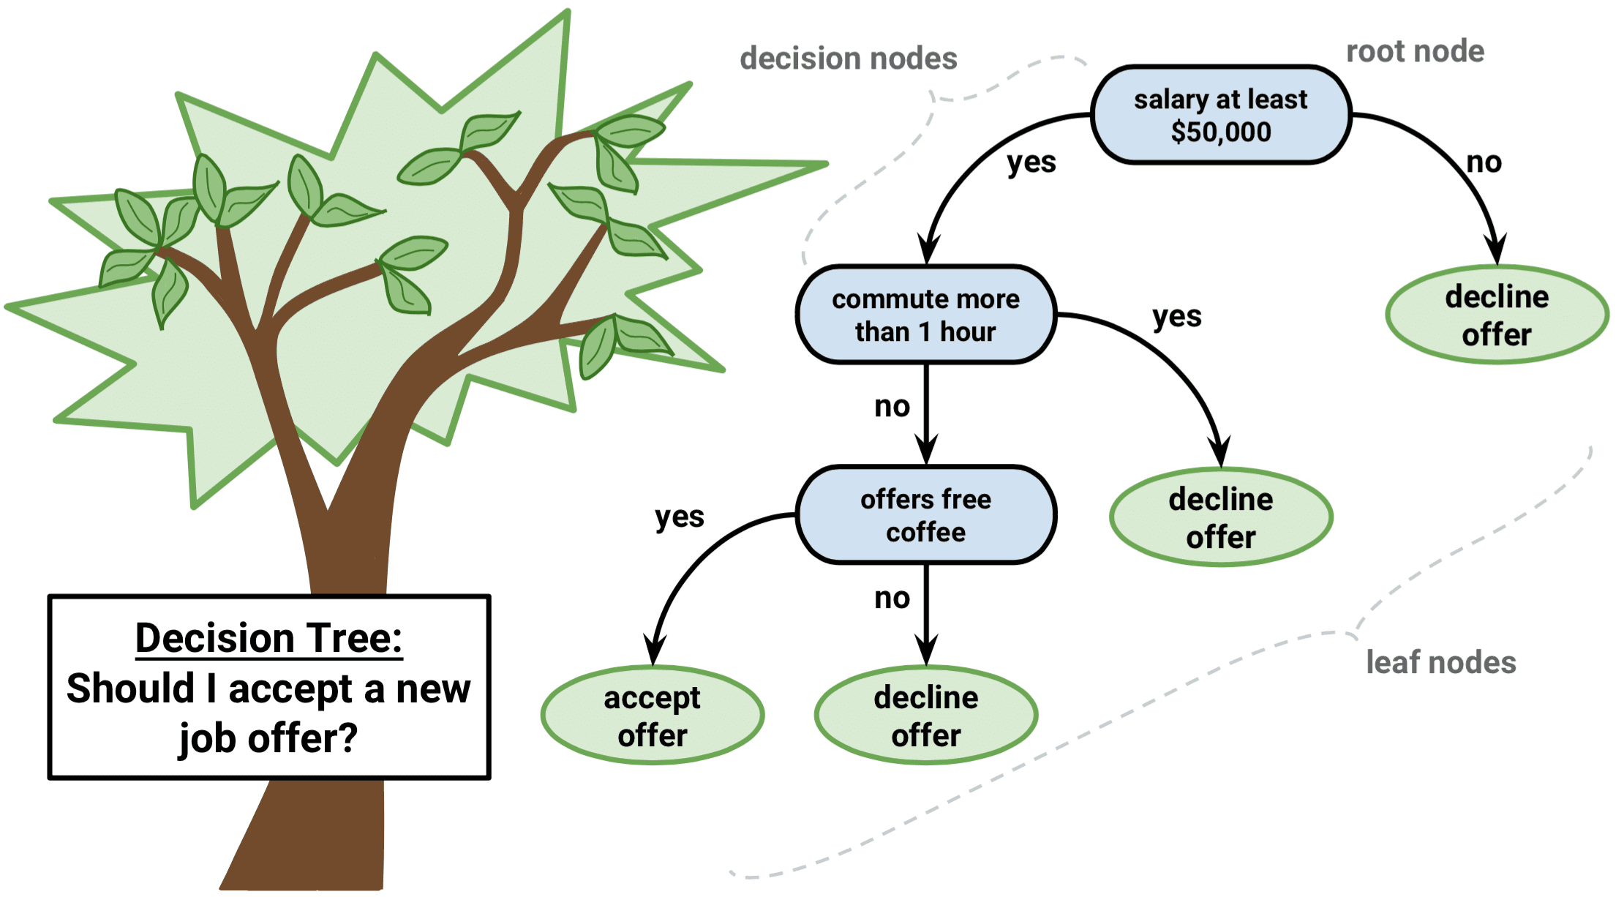

Slide 6
Homogeneity
The main goal in a decision tree algorithm is to identify a variable and classification that results in a more homogeneous distribution with reference to the target variable
The homogeneous distribution means that similar values of the target variable are grouped together so that a concrete decision can be made

Slide 7
Income | Education | Family size | Type of car
200,000 | 1 | 4 | Luxury
30,000 | 1 | 4 | Compact
75,000 | 2 | 3 | High-end
90,000 | 3 | 6 | Economy
30,000 | 2 | 2 | Compact
125,000 | 2 | 2 | Luxury
130,000 | 3 | 6 | Economy
300,000 | 3 | 2 | Luxury
250,000 | 2 | 3 | Luxury
128,000 | 2 | 5 | Economy
35,000 | 3 | 1 | Compact
… | … | … | …
Rule Archeology
Income >= 200,000 → Luxury
Income <= 30,000 → Compact
(100,000 <= Income <= 200,000) and family size < 3 → Luxury
(100,000 <= Income <= 200,000) and family size >= 5 → Economy

Slide 8
Looking at the data on the type of car that people own along with other demographic information (made up for illustration), we might be able to infer some underlying “rules” about the kinds of cars that people own.
With the caveat that we have very little data above and cannot really make any serious inferences, the discussion that follows is only intended to illustrate what we will be studying this week. To really make serious inferences we need much more data.
From the data we might observe some patterns:
People making $200,000 or more seem to own a luxury car independent of other factors.
People making $30,000 or less seem to be owning a compact car, independent of other factors.
For people making between $100,000 and $200,000, it seems that they own luxury cars when the family size is 2 or less and own an economy car when the family size is 5 or more.

Slide 9
LOAN EXAMPLE

Slide 10
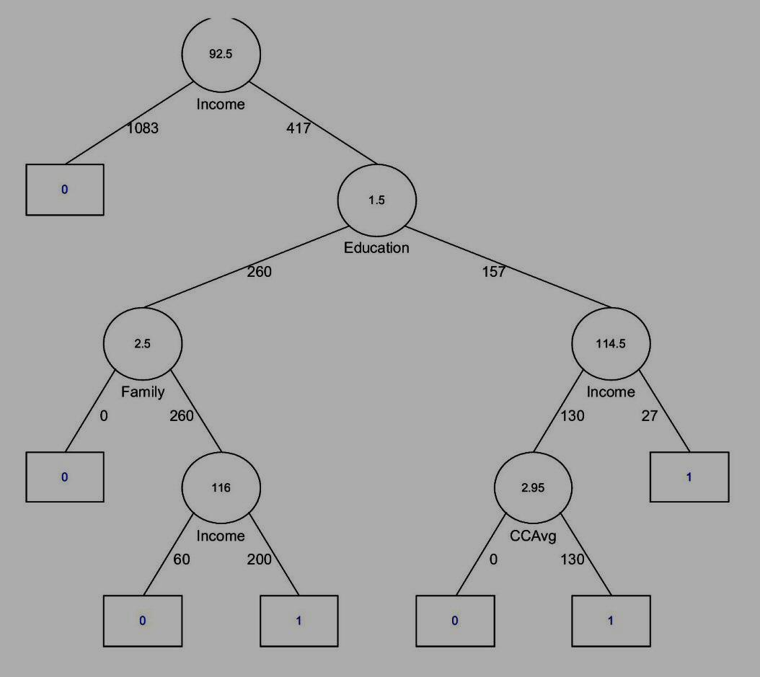
Classification Tree output for Bank loan offer acceptance data
<= 92.5
> 92.5
<= 1.5
> 1.5
<= 2.5
> 114.5
> 114.5
> 2.5
Reference: Data mining for business intelligence: Shmueli, Patel and Bruce, Wiley, 2006

Slide 11
<= 92.5
> 92.5
The tree implies rules. The simplest rule is highlighted.
<= 1.5
> 1.5
If income <= 92.5 then Non acceptor
<= 2.5
> 2.5
> 114.5
> 114.5

Slide 12
A more complex rule that the tree shows.
<= 92.5
> 92.5
If income > 92.5 and
education <= 1.5 and
family size > 2.5 and
income > 116 then
Acceptor
<= 1.5
> 1.5
<= 2.5
> 2.5
> 114.5
> 114.5
Can you condense this rule?

Slide 13
Find two more rules.
How many rules in all?

Slide 14
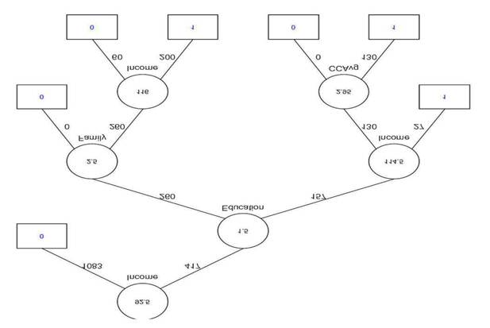
Tree?

Slide 15
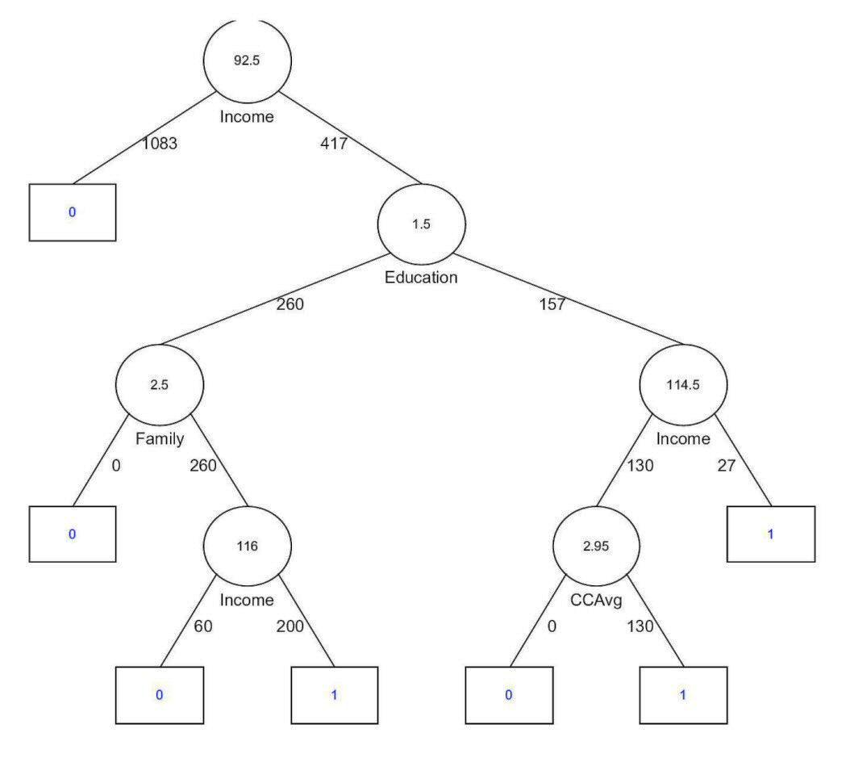
Root node
Interior node
Leaf node

Slide 16
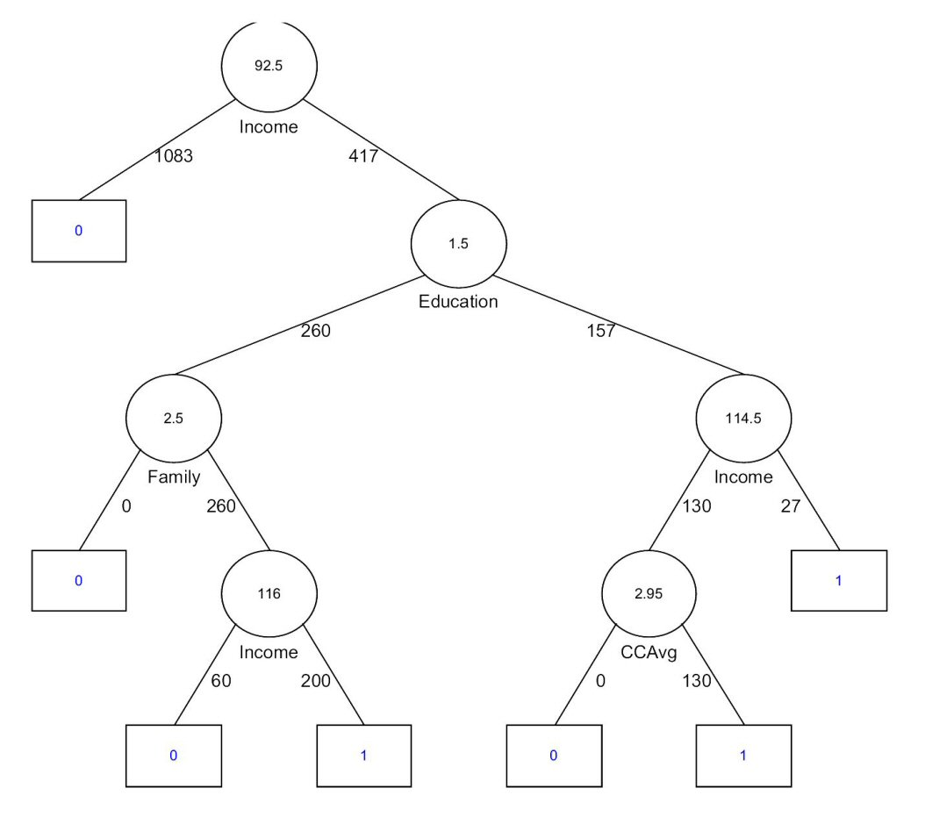
Training Partition
Income | Education | Family Sz | CC Avg | Acceptor?
… | … | … | … | …
… | … | … | … | …
… | … | … | … | …
… | … | … | … | …

Slide 17
Test Data
Income | Education | Family Sz | CC Avg | Acceptor?
… | … | … | … | Yes
… | … | … | … | No
… | … | … | … | No
… | … | … | … | …
Model says
No
Yes
No
…
How good is the model?

Slide 18
Widely applicable
Simple
Good performance
Why Trees?

Slide 19
Partitions all cases into two sets
Partitions all cases with income > 92.5 into two sets
Each “decision node” partitions its base cases into two sets based on some criterion

Slide 20
What does a set of rules do?
All cases
Cases satisfying rule 2
Cases satisfying rule 1
Cases satisfying rule 4
Cases satisfying rule 3
Cases satisfying rule …

Slide 21
A complete set of rules divides all the cases into disjoint sets such that each set of cases matches a single rule.
The above statement is not entirely accurate. It represents an idealized situation that will seldom be applicable in the real world.
It might initially appear that we can always achieve a set of rules that provide perfect matches – after all can we not create a rule for every case? If we do that we will have a huge number of rules, but they will all be perfect. Does this seem to be valid?
In reality the above approach will not generally be valid. We could have two cases with identical values for all the predictor variables, but having different values for the target variable. Concretely, we might have two cases with the same values for income, education, family size and credit card average and yet one of them accepted the loan offer and the other did not. In this case, no matter what rule matches these two cases, the rule can never be correct for both cases because they differ in the value of the target variable.
From the above example, we can see clearly that we will not pursue perfect rules. In machine learning we should not expect perfection. Instead we are looking for patterns that apply in enough cases to be of some use.

Slide 22
We are looking for lift – that is to beat the averages by a reasonable margin so that applying our models is better than doing things randomly or using more or less obvious ideas.
We see that the set of rules partitions the cases, with each partition consisting of the result of applying a specific rule.
Although we cannot strive for perfection, we still want the partitions to be as homogeneous as possible. Suppose that a particular rule applies to 100 cases in our data set and these cases belong to several different target groups (say, many acceptors and many non-acceptors as well), then the rule might not be as good as another that applies to a majority of a single target group – for example, most of the applicable cases are acceptors. In this case, the rule is perhaps doing a good job of finding an underlying pattern.

Slide 23
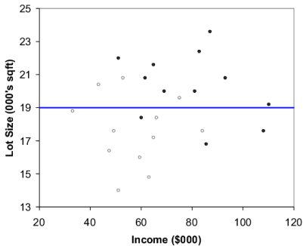
Ownership of riding mower example

Slide 24
This previous picture shows the all the data points. Owners are shown with dark dots.
As we observed earlier, while owners generally have high incomes and lot sizes, there are owners with somewhat low incomes and somewhat low lot sizes too.
We have seen that rules effectively partition the data set into a sets of disjoint cases with each set being predominantly homogeneous (say acceptors or non-acceptors). Our procedure for finding rules therefore revolves around building these homogeneous partitions. Once we have that, the rules simply follow.
We want to divide this whole space into regions that contain predominantly owners or non-owners, and derive rules from there.
This procedure is called “recursive partitioning.”

Slide 25
Partitioning
19
<= 19
> 19

Slide 26
In the above case, our overall region is a rectangle (because we have two variables and therefore have a two-dimensional space) and we have shown above a partition based on lot size. We have shown a line which divides the whole region into two parts. All values above 19 are in one partition and all values <= 19 are in the other.
We could have chosen to partition by income rather than lot size. Furthermore, having chosen lot size, we could have partitioned at several places.
Why lot size? Why 19?
Before we look at those issues, take a look at the figure – do you think that the partition is “good?” What would be your criterion o for deeming a partition to be “good?”

Slide 27
“Good” Partition Decision?
Owners predominate
Non-owners predominate

Slide 28
Let us think back to what we are trying to achieve with partitioning – we are trying to create regions with a lot of homogeneity. That is, we want to create regions that have predominantly owners or non-owners.
The partition at 19 seem like a good one because the resulting two regions are much more homogeneous than the original partitioned space was. We now have a majority of owners in the top region and a majority of non-owners in the bottom partition. Visually observe that drawing the partition at any other value of lot size would not have helped us to do better because the two resulting regions would have been less homogeneous.
If we had three variables instead of two, then each partition will be a three dimensional space and partitioning is achieved by means of a plane as shown in the next slide.

Slide 29
Partitioning in Three Dimensions
Income
Income > 95
Income <= 95
Fam. size
Plane to partition a three dimensional regions into two regions
Education

Slide 30
Recursive Partitioning
Select a partition …

Slide 31
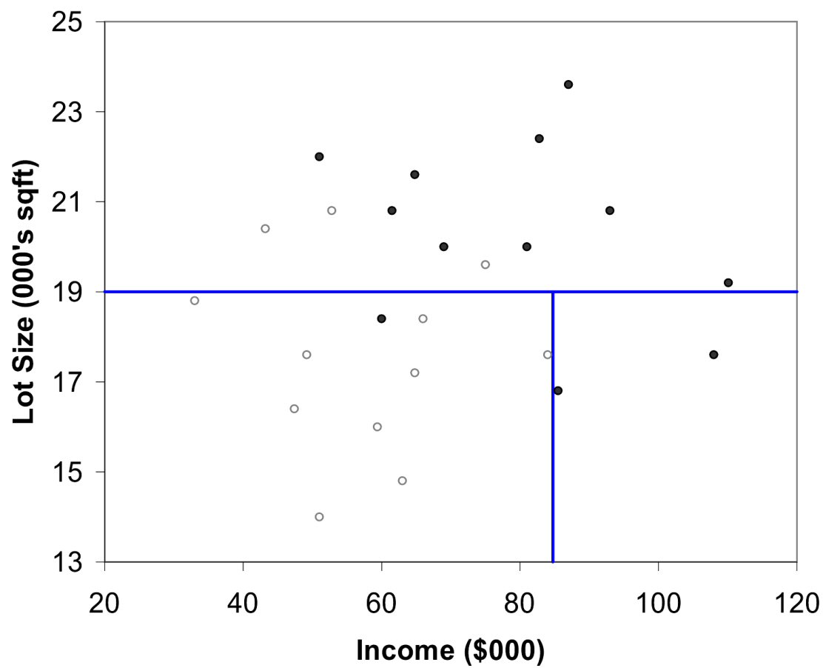
Recursive Partitioning
… and divide it again
19
<= 19
> 19
84.75
<= 84.75
> 84.75

Slide 32
... and again divided into two, this time based on income. Those cases with income less than or equal to 84.75 went to one partition and the rest went into another.
Note however that we are only partitioning the selected region. The top portion remains as is for now.
Several big questions remain:
Why did I pick the variable lot size selected for the prior partition?
Why did I choose to partition at 19 and not some other value?
Why did we select the bottom region?
Why did we select Income as the variable for partitioning?
Why did we select 84.75 as the specific value to partition on?
We have already hinted that “homogeneity” of the regions resulting from a partitioning step guides our choices.

Slide 33
Your Turn
Where would you place the next partition?

Slide 34
Take a look at the situation and consider where you might choose to place the next partition. Remember, you have to select a region (from among the three above) and also select where exactly to draw the line.
For example, suppose you chose the topmost region, you then have to decide whether to partition on lot size or income. If you choose lot size, the you will select the value to partition on. Again suppose you choose 23 (just for illustration only, might not be a good choice), then you are effectively drawing a horizontal line running through the selected region at 23 on the Y axis

Slide 35
Perfection not always possible.
Under what conditions might obtaining perfect partitioning be impossible?
Answer: If two cases have the same values for the predictor variables and differ only in their values for the target variable, then getting a set of rules that performs perfectly is impossible.

Slide 36
Put all training cases into one set
Procedure to Grow Trees
Select an impure set to partition
Consider all possible partitions of the set
No
As pure as feasible?
Perform the “best” partitioning
Stop
Yes

Slide 37
We want each group to consist only of one type of case (Owner or Non-owner).
Therefore, we need a measure of the extent to which a group is impure (or lacks homogeneity). Clearly, if all the cases in a group are owners or all are non-owners, then the group is pure. On the other hand the maximum amount of impurity occurs when the group is perfectly heterogeneous. In the present example that would mean that the group consists of 50% owners and 50% non-owners. This is the maximum possible deviation that we can get from absolute purity when every member is of the same type. (A 60-40 or 70-30 mix of owners and non-owners is purer than a 50-50 mix because there is a tendency for the predominance of some group.)
When we partition, we change the measure of impurity.
At each stage, among all possible partitions, we select the one that results in the best improvement in the measure of purity. This is the same as saying that we choose the split that results in the best possible improvement in overall purity.

Slide 38
Homogeneity
The main goal in a decision tree algorithm is to identify a variable and classification that results in a more homogeneous distribution with reference to the target variable
The homogeneous distribution means that similar values of the target variable are grouped together so that a concrete decision can be made

Slide 39

Entropy
A measure of the randomness in the information being processed. The higher the entropy, the harder it is to draw any conclusions from that information.
Where H is the entropy. X is the dataset. P(x) is the proportion of x in X, n is the number of classes in the target variable

Slide 40
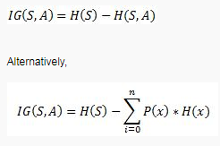
Information Gain
The amount of information gained about a random variable from another random variable. The difference between the entropy of parent node and weighted average entropy of child nodes.
Where IG(S,A) is the difference in entropy.
H(S) is the entropy of S
H(S,A) is the entropy of S given A.

Slide 41


Gini Index: A Measure of Impurity of a Set
m: number of classes
2 – Owner and Non-Owner
p_{k}: proportion of elements in class k
12 Owners and 12 Non-Owners
p₁ and p₂ equal 0.5

Slide 42
Gini Calculation for Initial Set
m
2 – Owner and Non-Owner
p₁
0.5: 12 Owners out of 24
p₂
0.5: 12 Non-owners out of 24

Slide 43

Entropy: Another Impurity Measure of a set
m: number of classes
2 – Owner and Non-Owner
p_{k}: proportion of elements in class k
12 Owners and 12 Non-Owners
p₁ and p₂ equal 0.5

Slide 44
Entropy Calculation for Initial Set
m
2 – Owner and Non-Owner
p₁
0.5 – 12 Owners out of 24
p₂
0.5 – 12 Non-owners out of 24

Slide 45
Gini: 0.5
Entropy: 1
Find a split to improve this …

Slide 46
Finding the First Split
Lot Sizes -- sorted
Can split between any two successive values that are different
14 | 14.8 | 16 | 16.4 | 16.8 | 17.2 | 17.6 | 17.6 | 17.6 | 18.4 | 18.4 | 18.8 | 19.2 | 19.6 | 20 | 20 | 20.4 | 20.8 | 20.8 | 20.8 | 21.6 | 22 | 22.4 | 23.6
Incomes -- sorted
33 | 43.2 | 47.4 | 49.2 | 51 | 51 | 52.8 | 59.4 | 60 | 61.5 | 63 | 64.8 | 64.8 | 66 | 69 | 75 | 81 | 82.8 | 84 | 85.5 | 87 | 93 | 108 | 110
38 -- Try all and pick the one that reduces overall impurity most

Slide 47
Gini: 0.5
Entropy: 1

Slide 48
First Split – Lot Size 19
9 owners, 3 non-owners
Gini: 0.375
E: 0.811
Combined Gini:
Weighted avg: 0.375
(reduced from 0.5)
Combined Entropy:
Weighted avg: 0.811
(reduced from 1)
Gini: 0.375
E: 0.811
3 owners, 9 non-owners

Slide 49
Choosing Subsequent Splits
Several splits possible on this group (income and lot size)
Consider all possibilities and calculate the overall Gini/Entropy under each. Choose the best.
Several splits possible on this group (income and lot size)

Slide 50
Second Split – Income $84K

Slide 51
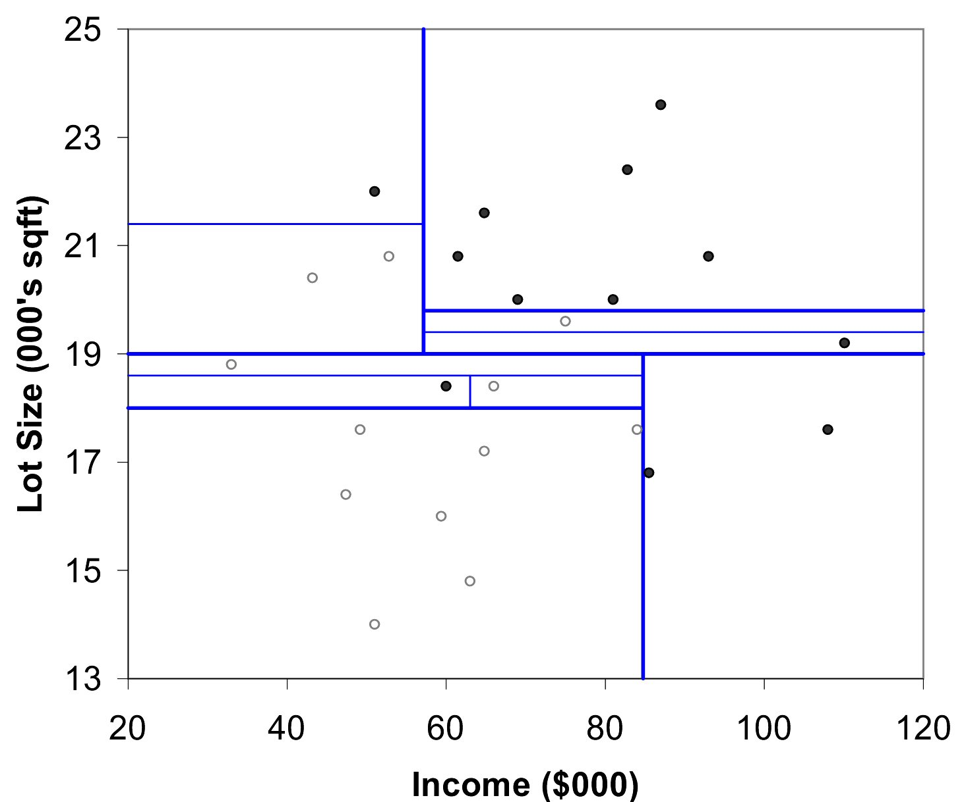
After All Splits
All groups pure

Slide 52
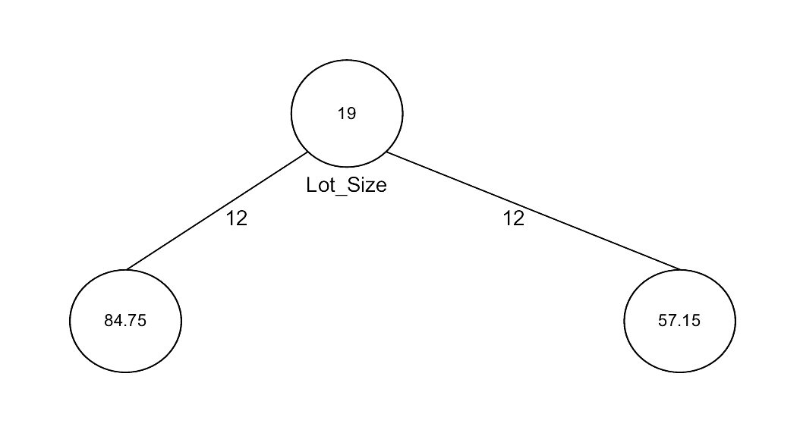
Tree Representation
Split value
Variable being used to split
No of cases <= 19
No of cases > 19

Slide 53
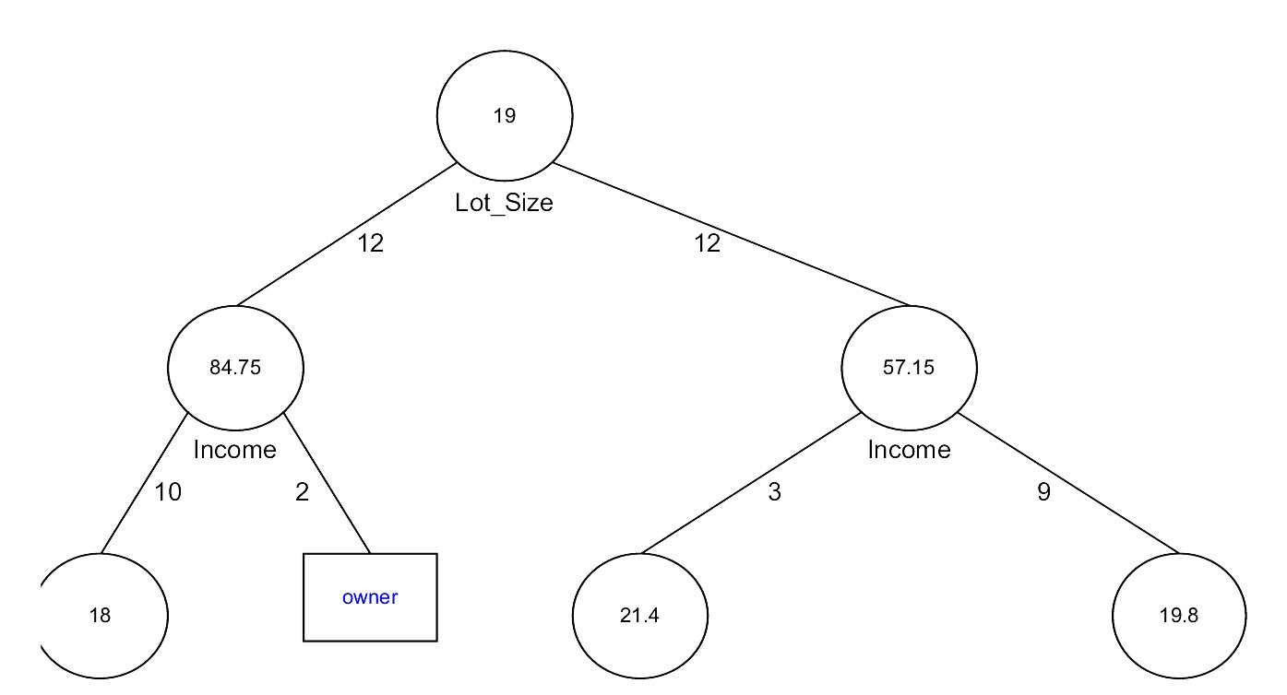
Tree -- After 3 Splits

Slide 54
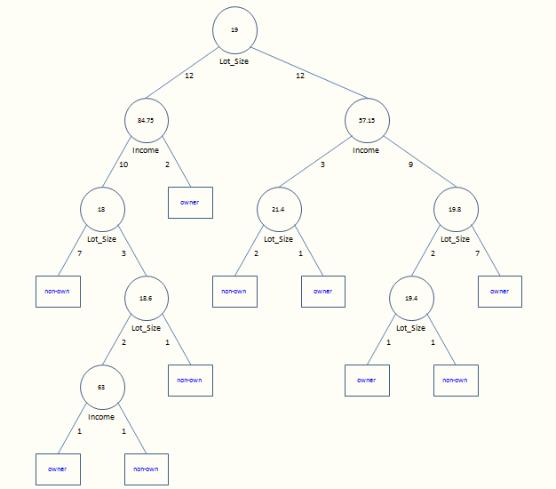

Slide 55
After All Splits

Slide 56
Your Turn
1
2
3
4

Slide 57
Answer
2
4
1
3
1
2
3
4

Slide 58
Iterative dichotomizer 3 (ID3) algorithm steps (uses entropy)
Calculate the initial entropy of the system based on the target variable.
Calculate the information gains for each candidate variable for a node. Select the variable that provides the maximum information gain as a decision node.
Repeat step 2 for each branch (value) of the node (variable) identified in step 2. The newly identified node is termed as leaf node.
Check whether the leaf node classifies the entire data perfectly. If not, repeat the steps from step 2 onwards. If yes, stop.

Slide 59
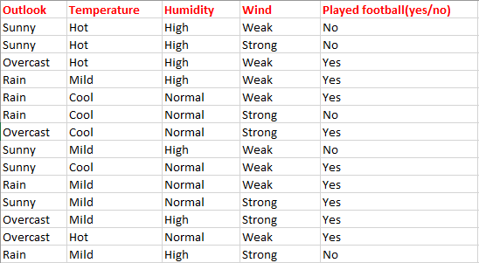
ID3 algorithm example

Slide 60
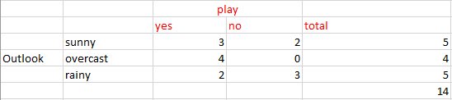
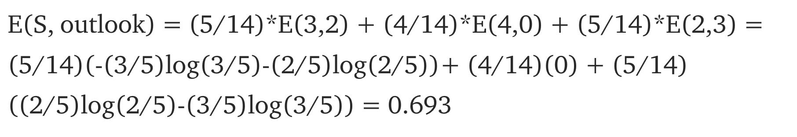
Candidate Variable: Outlook

Slide 61
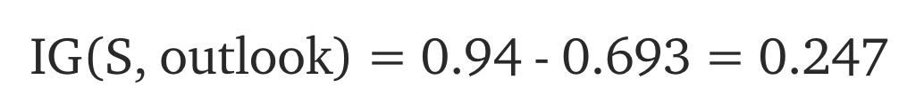
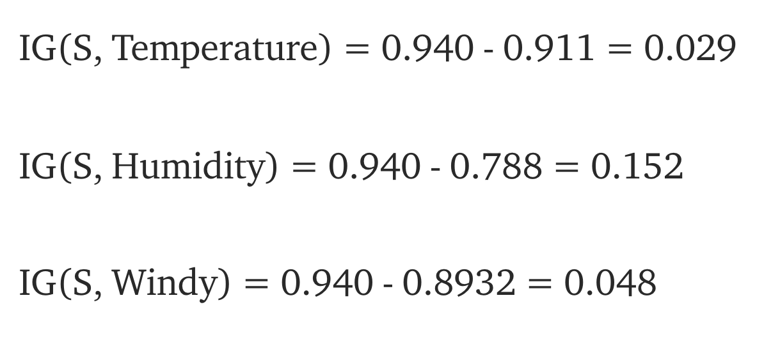
Compare Info Gain for all variables
Highest Information Gain is for outlook. Outlook is first decision node

Slide 62
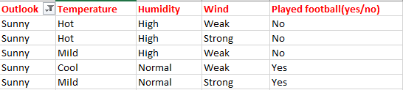
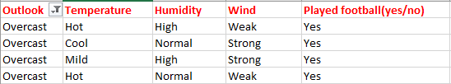
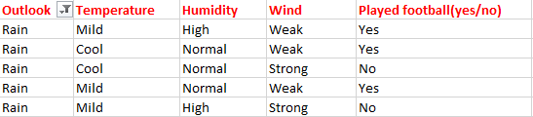

Slide 63
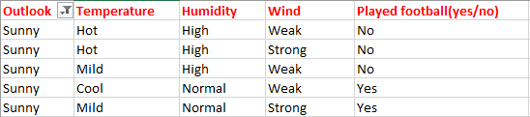
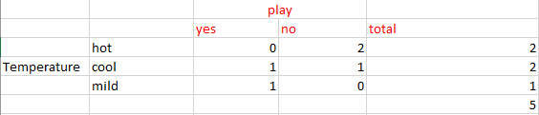
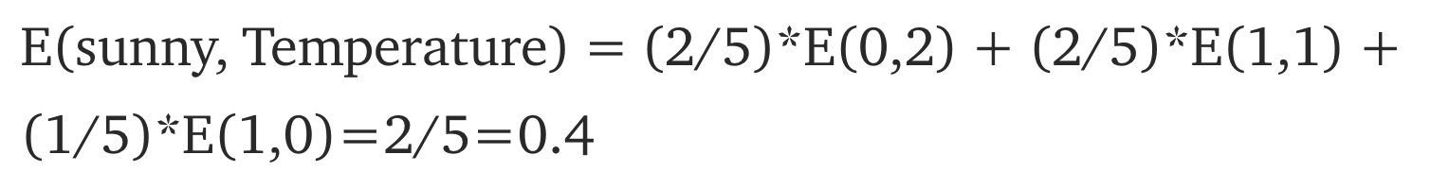

Slide 64
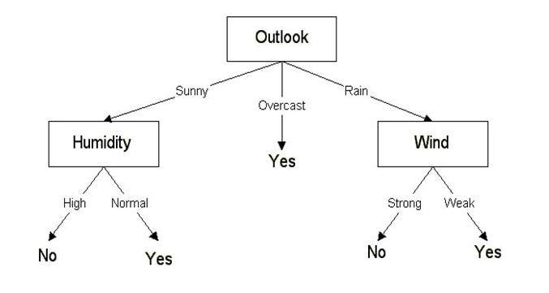
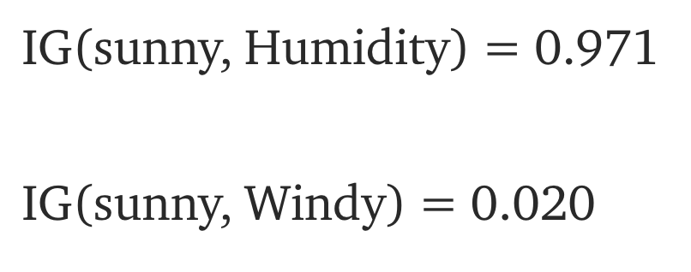
Humidity has the highest IG. Continue building out the decision tree

Slide 65

Gini Impurity
A measure of how often a randomly chosen element from the set would be incorrectly labeled if it was randomly labeled according to the distribution of labels in the subset.

Slide 66
CART algorithm steps (uses Gini)
Calculate the gini index based on the target variable.
Calculate the gini gains for each candidate variable for a node. Select the variable that provides the maximum gini gain as a decision node.
Repeat step 2 for each branch (value) of the node (variable) identified in step 2. The newly identified node is termed as leaf node.
Check whether the leaf node classifies the entire data perfectly. If not, repeat the steps from step 2 onwards. If yes, stop.

Slide 67
CART algorithm example

Slide 68
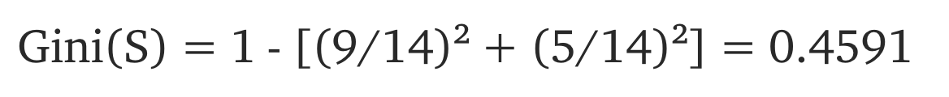
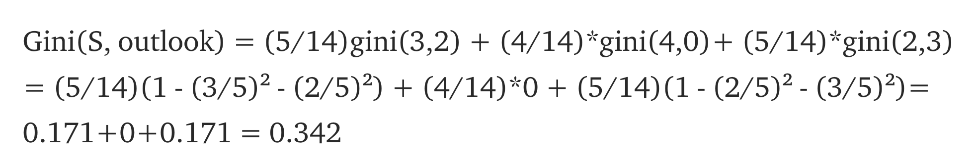

Slide 69
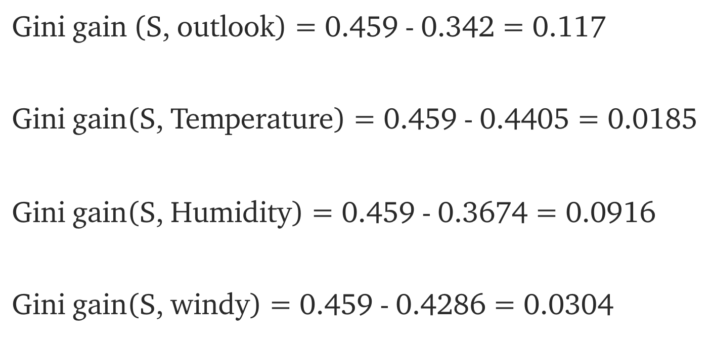

Slide 70
Handling numerical target variable
Sort the dataset based on the numerical variable in ascending order.
Mark the numerical variable ranges where the target variable transitions from one category to another.
Create a separate categorical variable with values corresponding to the thresholds for the transitions from step 2.

Slide 71
Pruning
Big tree likely to over-fit
Eliminate splits that do not reduce error rate very much

Slide 72
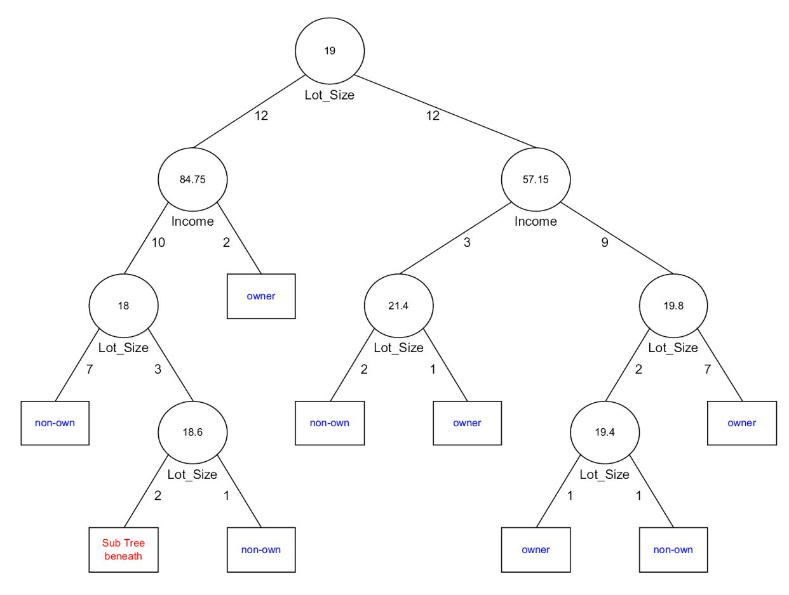
Splits Creating Small Groups

Slide 73
Pruning Example
Bad split. Eliminate

Slide 74
Pruning Example
Convert split into leaf node and eliminate sub-tree
Non owner
Majority

Slide 75
Recursive partitioning
Pruning using validation data

Slide 76
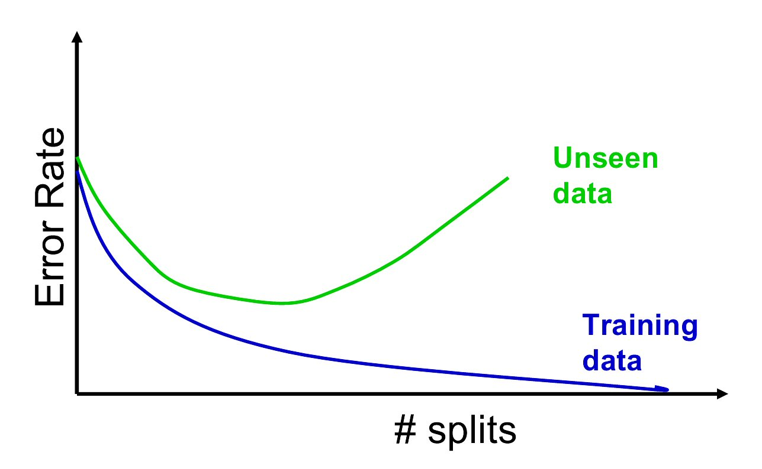
Pruning Approach
Choose tree corresponding to this point
Generate best trees of each size
Select tree with minimum error rate on test data

Slide 77
Tree Implies Rules
Advantages of rules
Transparent
Easy to explain
Eg: Insurance -- able to explain why claim was denied, avoid lawsuits

Slide 78
Advantages
Disadvantages
Easy to use and interpret
Variable selection is automatic
Only horizontal and vertical splits
Non-parametric
Sequential – could miss good splits
Missing data is not serious

Slide 79
Interactive example of decision trees on the housing market dataset

Slide 80
In depth tutorials on how to build decision trees from scratch:
Here
Here

Slide 81
Pruning in python
Plot decision boundaries

Slide 82
Ensemble methods
Combining multiple simple models (base learners) to get a better prediction than using any single model alone. See here
Bagging: Trains multiple trees on different bootstrapped samples of the data
Random Forests: Same as bagging but we also train the model using a subset of the predictors (or features called m)
Boosting: train multiple very simple models sequentially where the next model is trained on the “mistakes” of the previous model
Stacking:

Slide 83
Random Forest example
X = age, gender, cabin_class, income, city_of_origin
y= survived or not (1/0)
Data = (a, b, c, d, e, f)
Y = (1, 1, 0, 0, 0, 1)
Random Forest: Build 3 trees and combine prediction with m = 3
Tree 1: train_1 = (a,b,b,d,e,a) X_1 = age, gender, income ⇒ 1
Tree 2: train_2 = (b,b,c,e,d,f) X _2= age, gender, cabin_class => 1
Tree 3: train_3 = (a,b,c,d,e,e) X_3 = cabin_class, income, city_of_orging ⇒ 0
Answer: survived!

Slide 84
Boosting Example
X = age, gender, cabin_class, income, city_of_origin
y= survived or not (1/0)
Data = (a, b, c, d, e, f)
Y = (1, 1, 0, 0, 0, 1)
Create model M1 the simplest tree posible (single node tree)
Y_hat_1 = (0,0,0,1,1,1)
Create model M2 with emphasis on mistake from M1 Y_hat_2 = (1,1,1,1,0,0)
Create model M3 with emphasis on mistakes from M2 Y_hat_3=(0,1,1,1,1,0)

